Slide 1
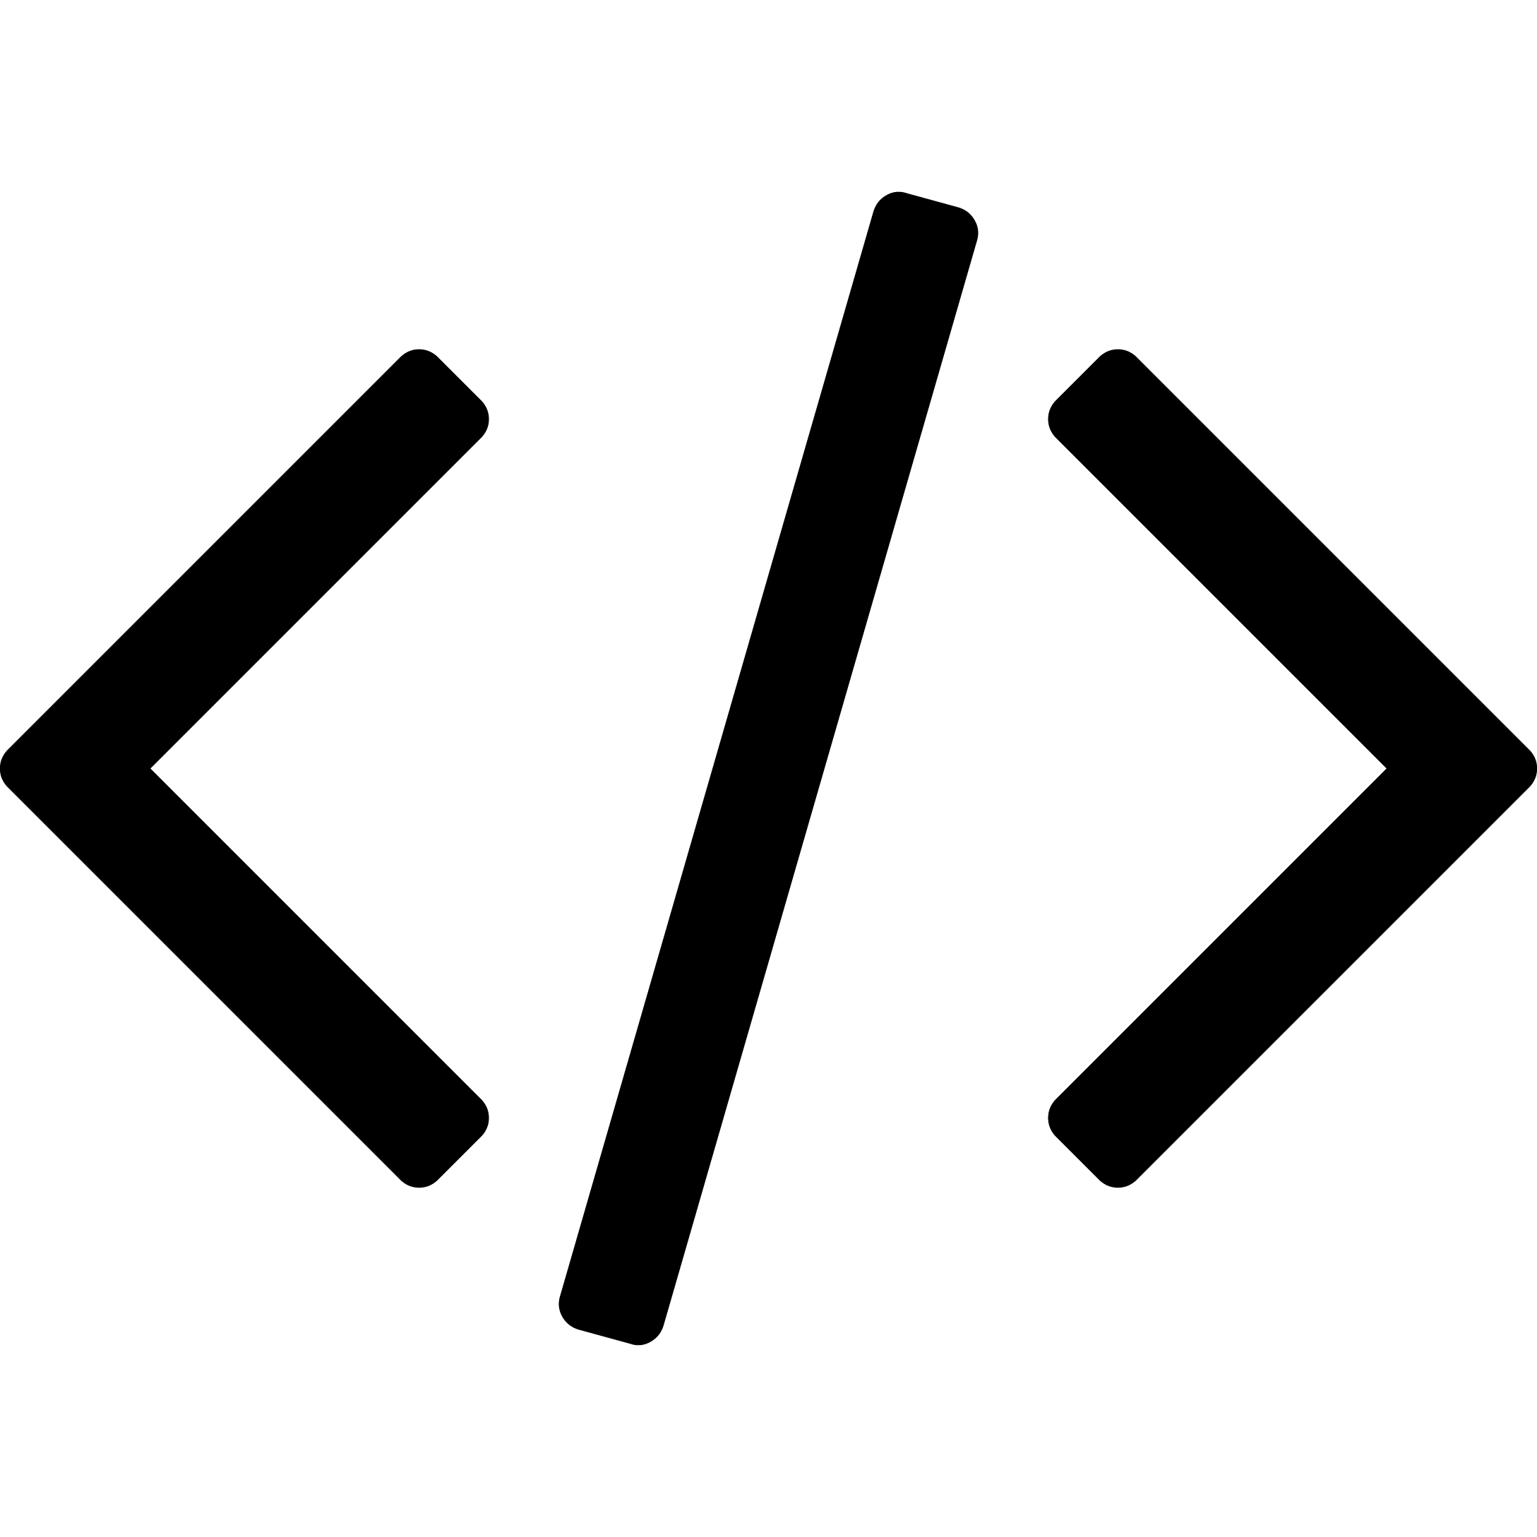
So Many Languages
- Team YAAS

Slide 2
Ever
feel like learning a
new programming
language?
Need
to convert one
language’s code
to the other?

Slide 3
Advantage
Our
Smart technology
Immediate language conversion
One of its kind language freedom
Voice to code templating
Easy to use
Accurate coding
Knowing logic is enough
Save time
Our
Audience
Students,
Learning has no age
Our
Potential
Limitless

Slide 4
Business Model
Free code templating and conversion for particular common languages like C++, Python, Java, etc
Paid packs for exclusive languages like Swift, PHP, JavaScript, etc
Marketing
For every referral, points earned which help purchase premium and exclusive language packs
Schwags and discount benefits for Campus Ambassadors

Slide 5
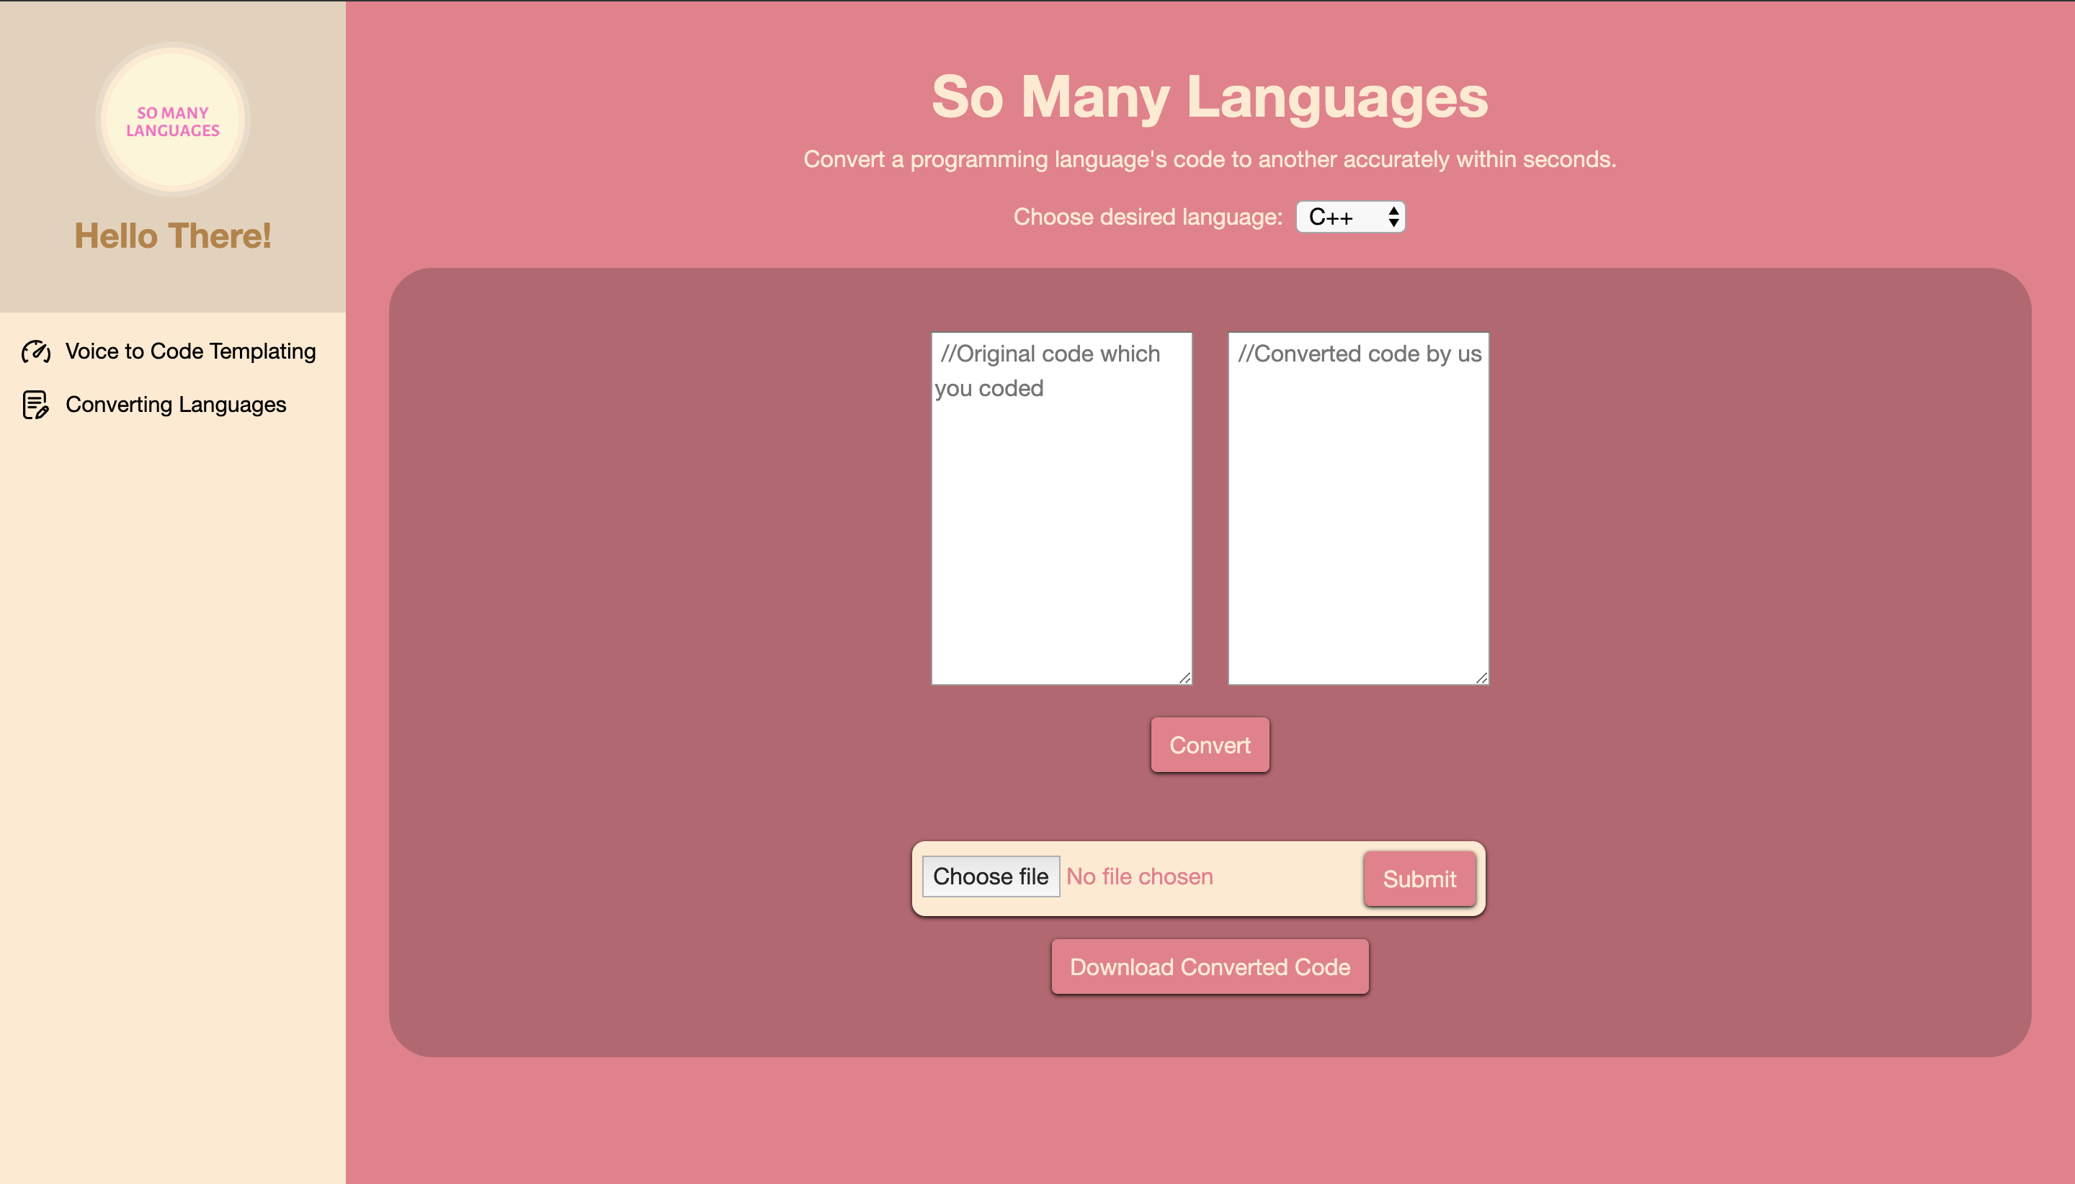
Screenshots

Slide 6
Screenshots

Slide 7
Technologies Used
HTML/ CSS/ JavaScript/ Bootstrap
Flask
GCP
AWS
domain.com
IBM Watson
PHP
Advanced Python
C & C++

